Slide 1

Analyzing U.S. Aviation Accidents
RECOMMENDATIONS OF SAFE AIRCRAFT FOR A CLIENT

Slide 2
Project Overview
Goal
Understand trends and risk factors in aviation accidents in the US market to inform aircraft operation and acquisition decisions.
Dataset used
Raw Aviation Accident data obtained from a Kaggle dataset.
Tools Used
Python for cleaning my dataset and visualisations and Tableau for visualisation.

Slide 3
Business Understanding
Challenge: Diversifying into aviation requires strong risk management.
Objective: Minimize accidents and maximize operational safety by choosing low-risk aircraft for purchase.
Deliverable: Actionable insights and recommendations for aircraft selection.

Slide 4

The Data Journey
Loading and Cleaning Raw Data
Conclusion and Recommendations
Exploratory Data Analysis (EDA) and Visualisations
Tableau Visualisation of Cleaned Data

Slide 5
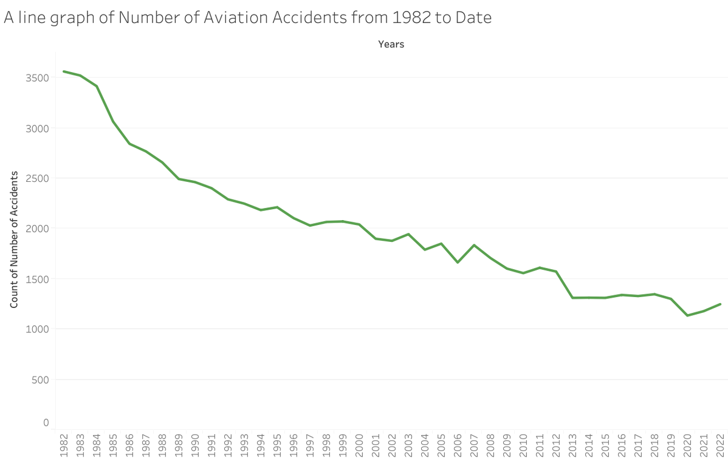
Accident Trends Over Time
General decline in incidents over time suggests improving safety standards.
The environment for investing in an aviation business is favourable for new entrants as a result.

Slide 6
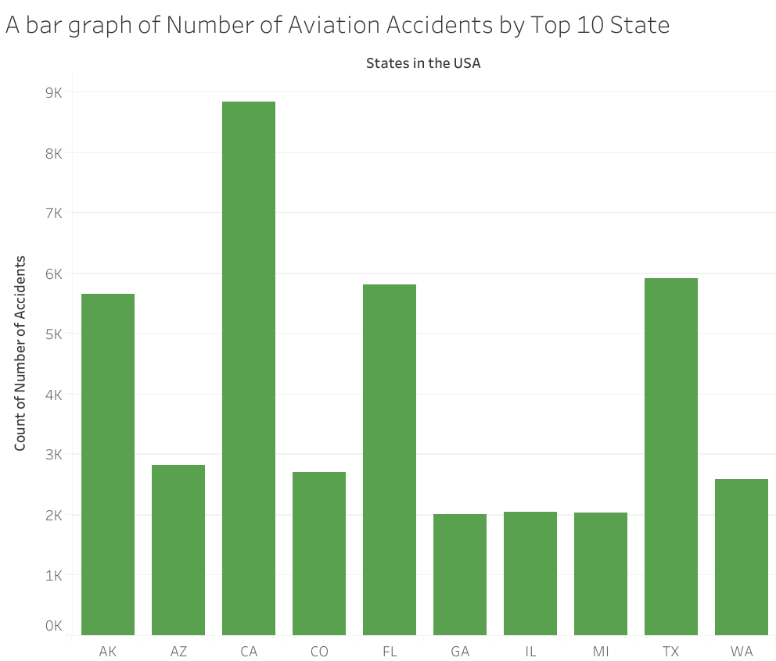
Geographic Hotspots
California, Texas, Florida, and Arizona have the highest accident counts, likely due to high traffic and favorable flying conditions.
Recommendation - While these are the most attractive markets, the client should prioritize safer plane types and safety standards.

Slide 7
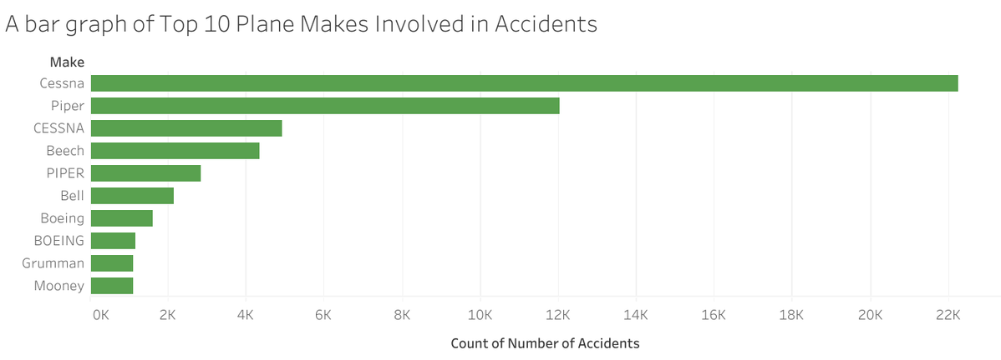
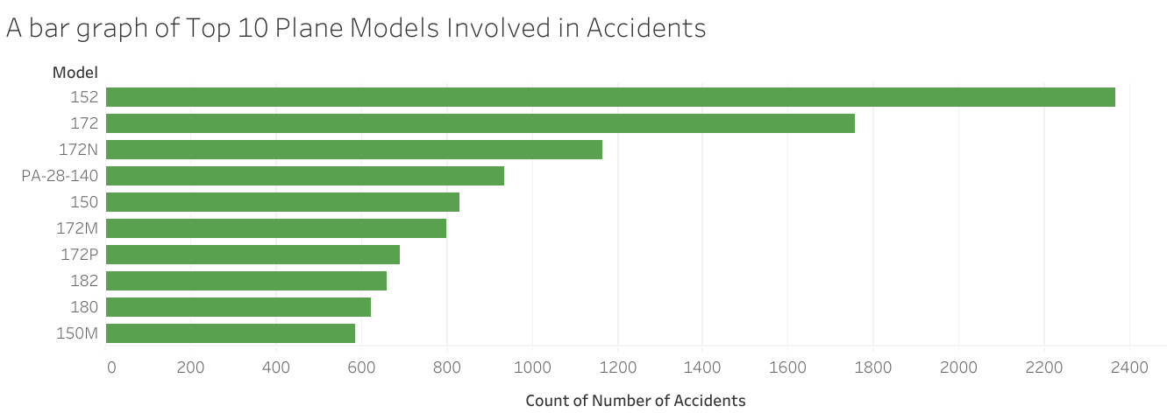
Aircraft Models and Engine Types
Cessna models and single-engine planes are involved in a disproportionate number of accidents.
Recommendation - The client should avoid the risky plane makes and models and seek out safer alternatives.

Slide 8
Key Business Recommendations
Aircraft Model Selection: Prioritise models with lower accident involvement. Avoid historically accident-prone makes/models unless critical safety upgrades are verified.
Engine Type: Invest more in multi-engine aircraft; avoid an initial fleet heavily dependent on single-engine planes.
Maintenance and Pilot Training: Commit to robust training and maintenance programs.

Slide 9
Next Steps
Investigate specific safety records of shortlisted aircraft (accidents per flight hour if possible).
Engage with manufacturers for updated safety records and retrofit options.
Pilot a small fleet trial with continuous monitoring before full rollout.

Slide 10
Only when the tide goes out do you discover who’s been swimming naked.
Warren Buffett

Slide 11
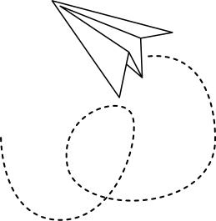
Thank You!
Keith Tongi
keith.tongi@student.moringaschool.com

